Slide 1
WORKING WITH THE MEDIA WHILE IN CRISIS MODE WNY Education Law Conference August 3, 2022

Slide 2
CRISES HAPPEN
Every district will be touched by crisis
Bomb threats
Guns
Sexual harassment
Bus accidents
Fires
Embezzlement
Remember-No district is exempt- It can and eventually will happen in your district.

Slide 3
PREPARE FOR THEM
Have a plan that is reviewed and updated regularly.
Make sure that staff is familiar with the district plan at all levels.
Conduct training so that your district plan is well executed when it needs to be.

Slide 4
COMMUNICATION IS IMPORTANT
Presume everyone has a cellphone and a social media account.
You will not have the luxury of time to respond as many social media platforms allow for live broadcast of events.
If you let a communication vacuum exist, someone other than the school or the district will fill it.
If let alone, a crisis will grow and become more difficult to control.

Slide 5
TODAY’S PANEL
Steve Bell- Steve Bell Communications
Nicholas Filipowski- Williamsville Central School District
Brendan P. Kelleher-Harris Beach PLLC
Karl W, Kristoff- Hodgson Russ LLP
Lou Petrucci- President, Buffalo Board of Education and Park District Representative

Slide 6
THE TWO PRONG APPROACH
Every crisis is a balance between the legal and the practical.
Your counsel will want you to say as little as possible to protect the district. This most likely will not be a viable option.
Parents, family members, the media, district staff, neighbors, local elected officials, etc. will all want information and updates.
This must be weighed against HIIPA, FERPA, law enforcement, future claims against the district, existing policies and procedures, etc.

Slide 7
WHAT CONSTITUTES A CRISIS? A CRISIS HAS MULTIPLE IMPACTS, INTERNALLY AND EXTERNALLY

Slide 8
WHAT IS AN ORGANIZATIONAL CRISIS?
Any event that interrupts normal operations, and simultaneously threatens your reputation.
It prevents ‘business as usual.’
Real crises come with big potential impacts. Loss of sales; damaged recruiting; fundraising fall off; loss of loyalty; mistrust.
PHOTO HERE

Slide 9
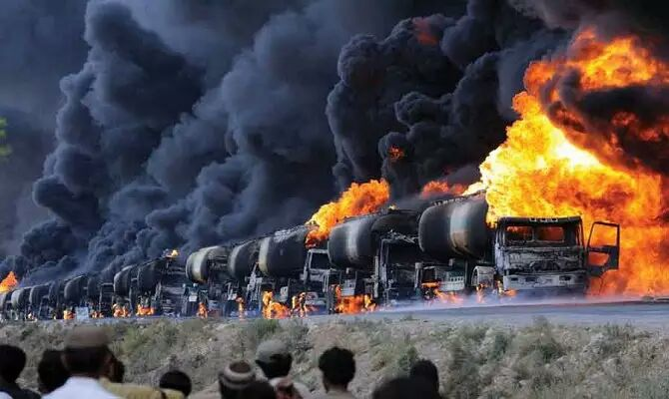
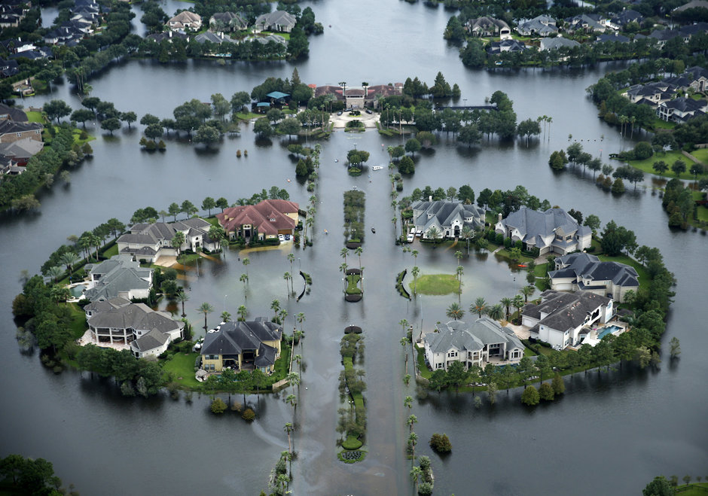
WHAT TRIGGERS A CRISIS IS NOT AS IMPORTANT AS THE RESPONSE
Superintendent firing; factory explosion; ransomware; CEO embezzlement; product recall.
What you do about it matters. How fast? How effective? How transparent? How do you maintain trust?
PHOTO HERE

Slide 10
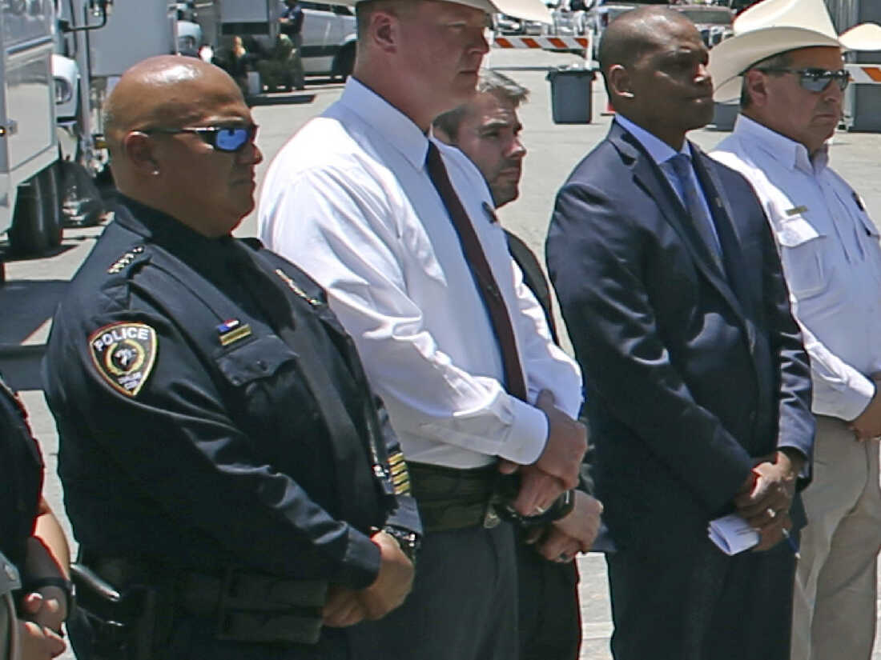
YOUR CRISIS MANAGEMENT RESPONSIBILITY
OBJECTIVE End the crisis as quickly as possible and return to business-as-usual – with credibility and reputation intact.
IT’S ABOUT TIME
A crisis is measured in time, not the severity of the crisis event. How fast and effectively you respond has everything to do with when you get back to normal.
PHOTO HERE

Slide 11
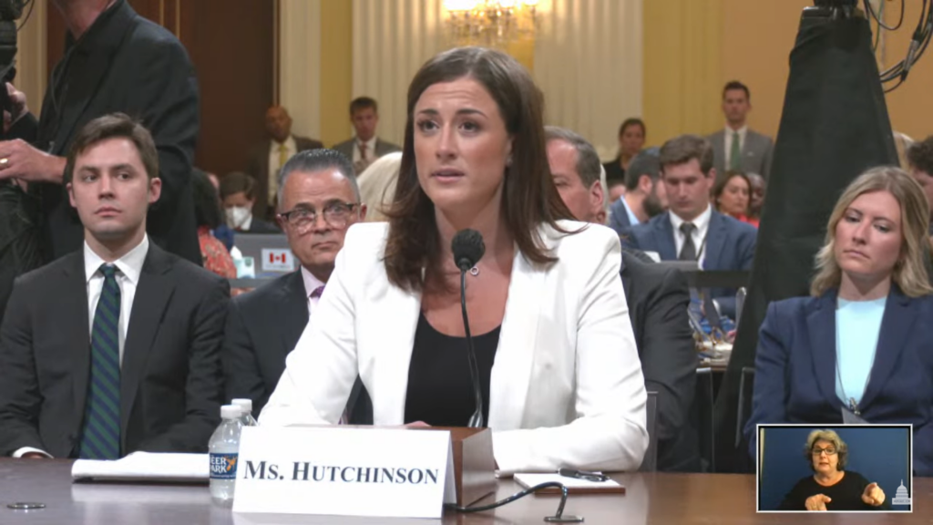
RULE 1: IF BAD NEWS IS GOING TO COME OUT ANYWAY, YOU SHOULD RELEASE IT ALL, PROACTIVELY AND PREEMPTIVELY
You only get one chance to make a good first impression.
Admitting mistakes can earn forgiveness.
Defuses anger, suspicion.
Helps the story fade.
Increases your credibility.
PHOTO HERE

Slide 12
RULE 2: SHARE BAD NEWS WITH FRIENDS FIRST
Internal communications first. Share news and your response so your friends know. Show loyalty.
Develop media relationships before crisis.
You want friends and stakeholders to defend and support you. Don’t give them reasons not to. Hear it from you, not the media.
Today, all employee communications are public statements.
PHOTO HERE

Slide 13
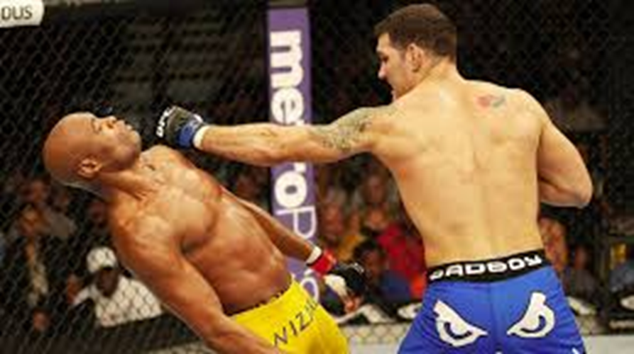
RULE 3: TAKE ALL YOUR HITS IN ONE ROUND
When your crisis response comes out piecemeal, the story lingers and damages your reputation more.
Research indicates when a negative story is repeated six to 10 times, perception is reinforced, eventually becoming “truth.
PHOTO HERE

Slide 14
RULE 4: ANSWER TOUGH QUESTIONS BEFORE THEY’RE ASKED OR BE READY TO ANSWER THEM FULLY
Anticipate the most uncomfortable questions and answer them completely in your opening statement.
You’ll defuse anger, suspicion and hostility because you won’t appear to be trying to hide or evade responsibility.

Slide 15
RULE 5: FACTS DISSOLVE RUMORS AND SPECULATION
Deliver facts fast.
Speculation creates uncertainty. Actions count far more than your words.
If you show you know what the problem is, and you’re working on it, you reassure that you are not ducking or hiding.
PHOTO HERE

Slide 16
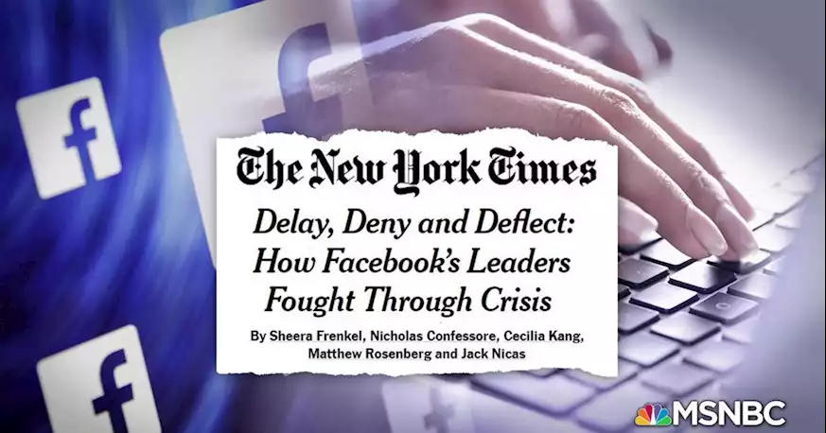
THE FLIP SIDE OF FACTS FAST? THE THREE D’s
How not to do it: Use the “death strategy,” aka, the Cover Up
DENY
DELAY
DECEIVE
Also, ‘no comment’ is not an option.
PHOTO HERE

Slide 17
BELIEFS
Good, bad, or indifferent, you should be communicating regularly with stakeholders and have meaningful conversations to build relationships.
There should be a consistent message shared for:
Transparency = Trust
Accuracy = Credibility
Frequency = Accountability
Availability = Accessibility
In a crisis, these are magnified and can be damaged.

Slide 18
BELIEFS AND RELATIONSHIPS
Transactional Vs. Transformative Communication
Some information shared is transactional
Did you communicate it? Yes or No?
Policy and procedures
Health and safety updates
Some information shared is transformative
Provides value- impact, growth, and development that allows you to build relationships with stakeholders – foundation based on the beliefs
Two-way communication
Work that showcases and/or highlights the programs, initiatives and accomplishments

Slide 19
HAVE A PLAN
Have a crisis communications plan and review it thoroughly and regularly
Clear chain of command for input/output of information
Proper coordination with local law enforcement
Prepared and approved media statement in coordination with legal counsel and/or local law enforcement
Communicate with leadership and administrative teams regularly, not just when there is a crisis
Follow-up is key
Talk through situations and concerns
Anticipate outcomes
Preparation is essential
Pay attention to local and national stories/trends and how that could impact your District/stakeholders
Be responsible to stakeholder questions and concerns

Slide 20
LEGAL CONCERNS ABOUT PUBLIC COMMENTS
Law of Torts
Defamation
"Stigma“
Other Statutes Impacting
District’s Response:
Freedom of Information Law ("FOIL")
Family Educational Rights and Privacy Act ("FERPA")
New York State Education Law § 2-d

Slide 21
Some People’s Inherent Distrust of Media May Impact Message / Method Used to Communicate that Message
"If you don't read the newspaper,
you're uninformed.
If you do read the newspaper,
you're mis-informed."
-- Mark Twain

Slide 22
SOME DO’S
Get the facts
Prepare
Answer the questions asked
Ask for “readbacks” and/or "do overs"
Be consistent
Know the distinctions between "off the record" and "on background“ – and be clear at the beginning of conversation with media member(s).
Know who in the media can be trusted

Slide 23
SOME DON’TS
Do not volunteer needless information
Admissions that could later be harmful in litigation
Avenues for discovery that may be otherwise unknown to adverse party
Do not place blame
Do not distort the truth – "Guild the Lilly"
Do not be afraid to state, "I don't know, but will find out.“
Do not overpromise that the District will take a certain specific action (e.g. terminate someone’s employment)
Do not create an artificial deadline for District to take action(s)
Do not make statements that restrict the District’s ability to later pivot to another course -- if facts and/or circumstances warrant such a change

Slide 24
SHOULD YOUR ATTORNEY BE THE SPOKESPERSON?
Opinions are divided:
Using an attorney as a spokesperson may look like there's something to hide; BUT
Sometimes the attorney will know best what information can and cannot be made public
If the message is litigation-related, the attorney is probably the best choice as the spokesperson.
The press prefers a high ranking official or officials with the District.

Slide 25
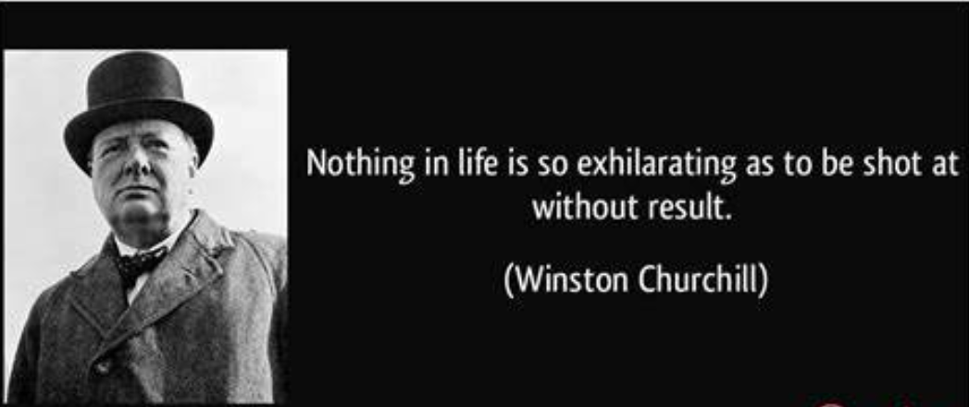
CONCLUSION
(1874-1965)

Slide 26
Presented by:
Steve Bell Brendan P. Kelleher
Steve Bell Communications Harris Beach PLLC steve@stevebellcommunications.com Bkelleher@harrisbeach.com
Nicholas Filipowski Karl W. Kristoff
Williamsville Central School District Hodgson Russ LLP
NFILIPOWSKI@williamsvillek12.org kkristoff@hodgonruss.com
Lou Petrucci
President, Buffalo Board of Education
LPetrucci@buffaloschools.org

